Slide 1
Classification and Quantification of Security Attack and Defences
Author: Terence Leong
Supervisor: Jin Hong

Slide 2

What is Connected Cars?
Cars that have a connection to the internet
Capable of sharing data with other devices
Development in technology has led to more threats

Slide 3
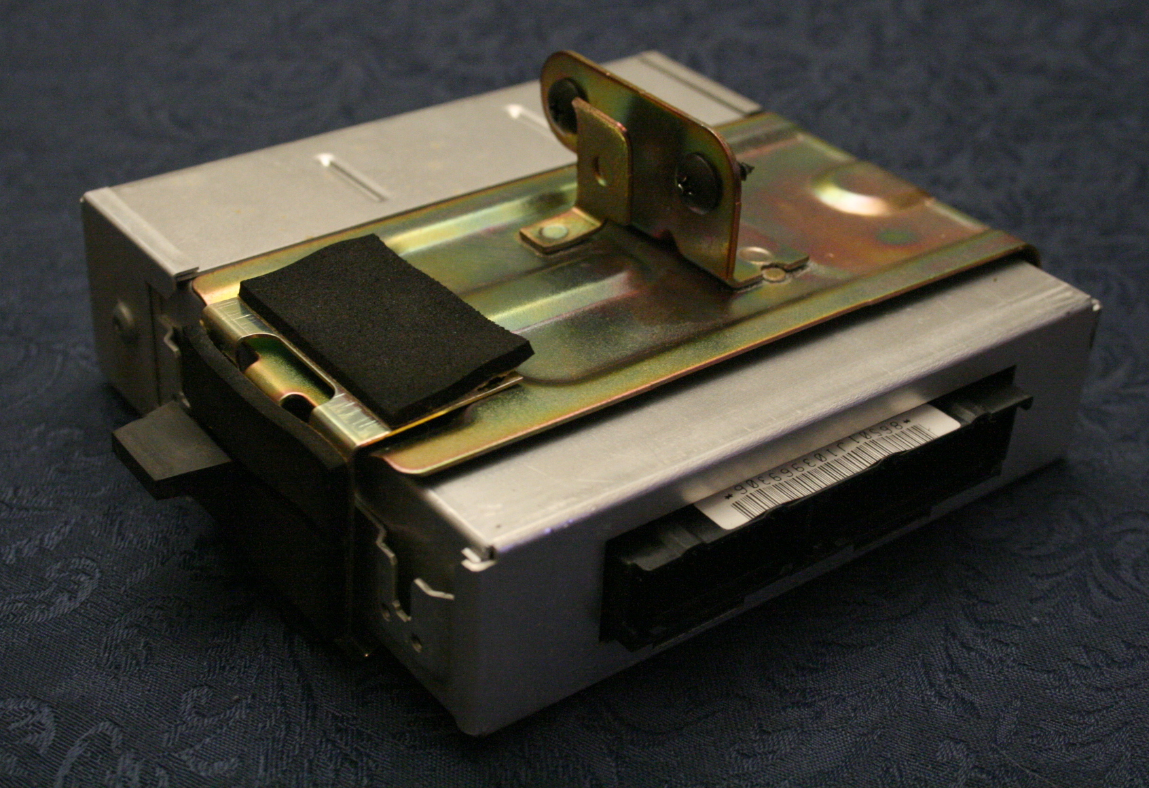
Connected Car Technology
Central communication point is the Electronic Control Unit (ECU)
Networks exist to provide efficient communication between modules
Most common is Controller Area Network (CAN) bus
CAN bus has major vulnerabilities and limitations

Slide 4

Attacks on Connected Cars
Attacks can be analysed from two different perspectives
Attack surface is the total sum of vulnerabilities
Attack vector is the pathway taken to achieve the outcome
Various attack vectors exist
Can be performed through internal or external attacks

Slide 5

What Has Been Done Before
Recent survey study dictates that there are four categories of defence
  Cryptography
  Network security
  Software vulnerability detection
  Malware detection
Cryptography is widely studied
No reliable solution has been found with cryptography
Some turned to Intrusion Detection Systems (IDS)

Slide 6
Goal of this Research
Develop a classification system that better illustrate nuances between attacks
Evaluate the impact of attacks on vehicular systems
Develop an optimisation algorithm to assist in determining most cost effective combination of defence to implement

Slide 7

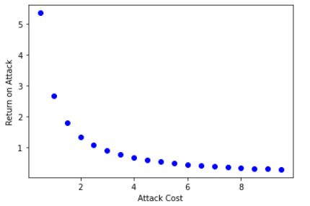




Quantifying Attacks
1. Attack cost
2. Attack impact
3. Attack risk
4. Probability of attack
5. Return on attack

Slide 8
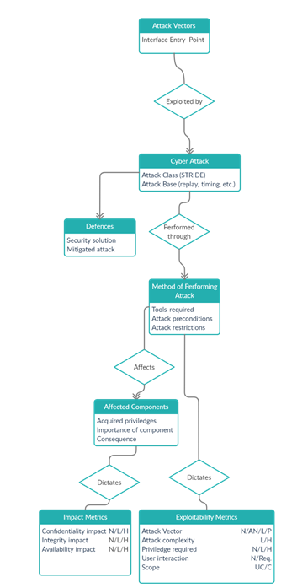
Classifying Attack
Entry point
List likely attacks
Determine method of performing attack
Determine affected components
Calculate vulnerability score through CVSS

Slide 9

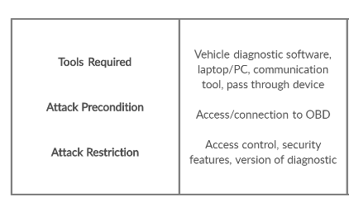
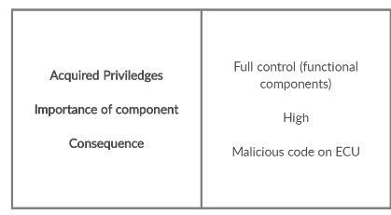
Example of Usage
Provides more information, thereby a better understanding of the attacks.
Easier to determine attack cost and return on attack
Select defences based on new information

Slide 10
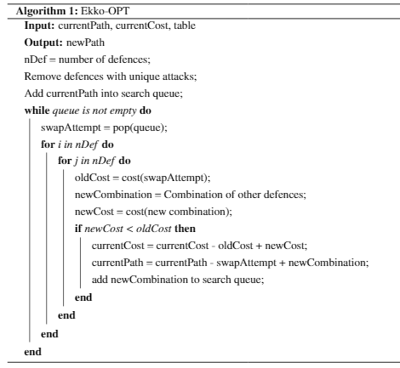
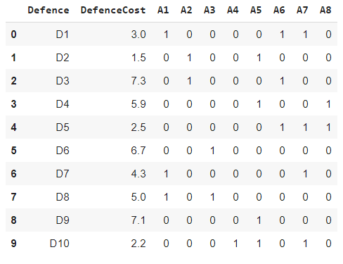
Optimising Defence Selection
Greedy approach -
[15.9] ['D10', 'D5', 'D1', 'D2', 'D6’]
Heuristic based approach -
[14.2] ['D10', 'D8', 'D1', 'D2', 'D5']
Given a set of defences, defence cost and attack set cover
Select the most optimal set of defence given by the lowest combination of cost to cover all attacks
-I started with a greedy algorithm
Then fed the ‘best’ local path into the heuristic-based approach above

